Slide 1

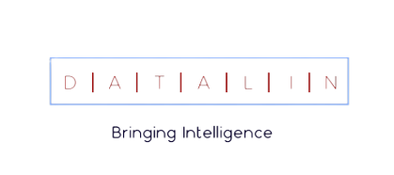
BC2: Predict Hotel Booking Cancellations

Slide 2
01
02
03
04
Agenda
Data Exploration
Further Analysis
05
Modeling
Evaluation
Deployment

Slide 3
01
Data Exploration
A look into the current Business reality
01

Slide 4
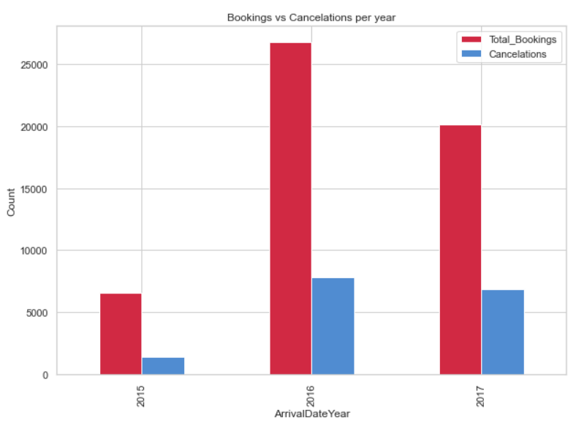
Bookings vs Cancelations per year
02

Slide 5
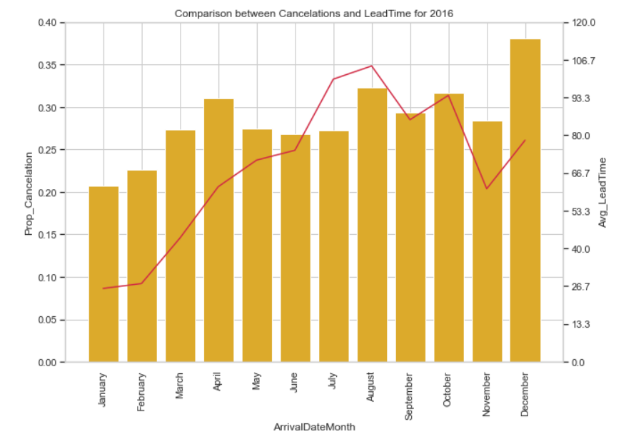
Comparison between Cancelations & Lead Time in 2016
03

Slide 6
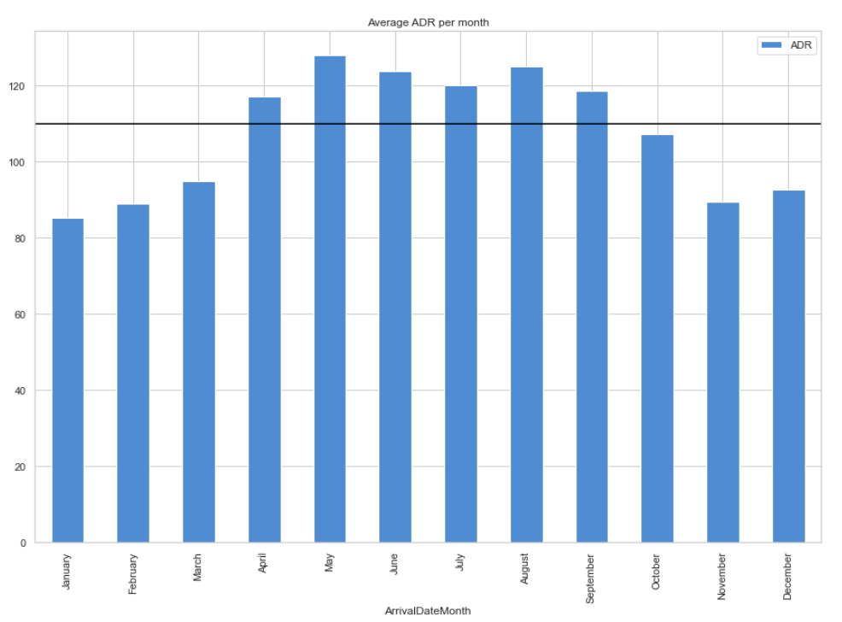
Average ADR per Month
High Season: April, May, June, July, August, September
Low Season: January, February, March, October, November, December
04

Slide 7
02
Further Analysis
Anomalies & Treatment Choices
05

Slide 8

Season’s Profile
High Season
Low Season
Is the customer a returner?
How does booking ahead affects the behavior?
Is age a booking factor?
How does the price affect the behavior?
Is it a weekend getaway?
Has the customer canceled before?
06

Slide 9
03
Modeling
Process & Final Predictive Models
07

Slide 10
Taking Advantage of the Data’s Characteristics
Test
2015
2017
2016
Train & Validation
08

Slide 11

Prediction Meaning
Prediction | Business Understanding
True Positive | The booking was correctly identified as a cancelation
True Negative | The booking was correctly identifed as a non-cancelation
False Positive | Potential Overbooking: A misprediction of cancelation
False Negative | Empty Room Risk: A misprediction of non-cancelation
Possible Loss of Revenue
Expenses with Reallocation
09

Slide 12
High Season Metrics
8.7%
6.2%
Cancelation Rate
Overbooking Risk
10

Slide 13
Low Season Metrics
7.7%
10%
Cancelation Rate
Overbooking Risk
11

Slide 14
04
Evaluation
What is the performance of the Predictive Model?
12

Slide 15
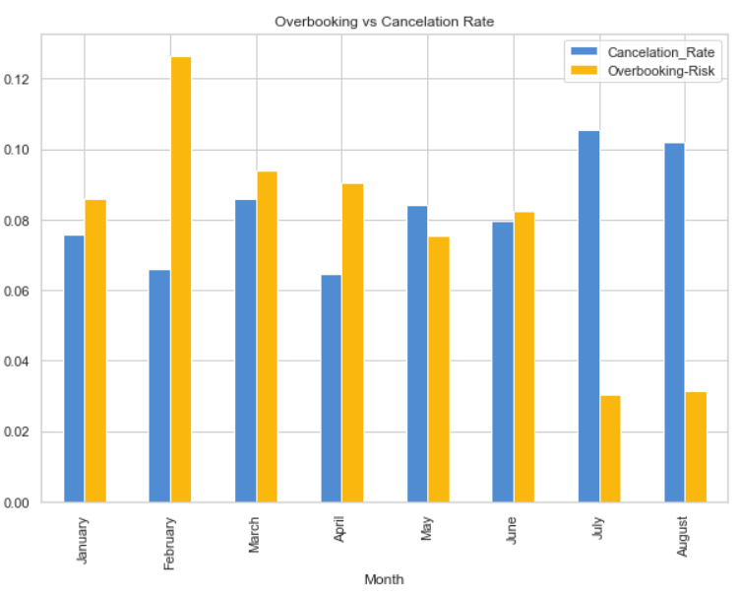
Overbooking vs Cancelation Rate
13

Slide 16
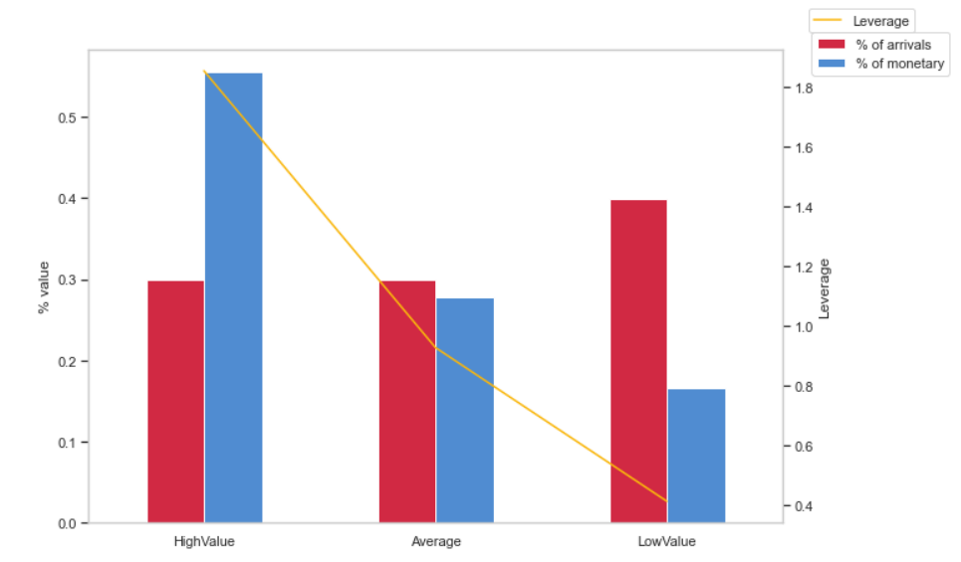
Leverage Analysis on Arrivals
14

Slide 17
05
Deployment
What is the next step?
15

Slide 18


Future Prospects
2022
2019
2021
16

Slide 19
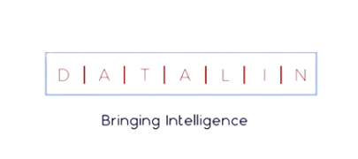
Thank you!
17

